Slide 1


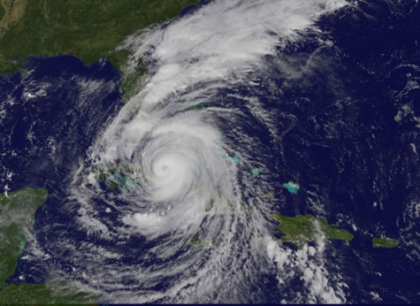
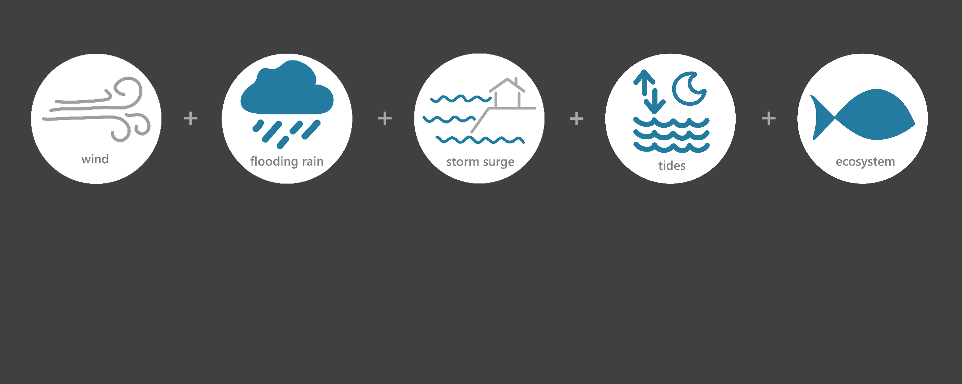

[ SEP 8 – SEP 12, 2017 ]
HURRICANE IRMA
TS
Category (tropical storm)
10
Inches of Rain
65
Miles per hour of Max Wind Gusts
5.9
Feet of Storm Surge (max)*
Image Credit: NASA NOAA GOES, taken on September 9, 2017
Monitoring the Impact of Hurricane Irma at “GTM NERR”
On Sept. 11th, Irma passed between Tampa and Orlando as a category 1 storm. It then "weakened" to a tropical storm about 20 miles west of Gainesville. By the afternoon, its center moved over south Georgia just west of Valdosta. Even though Irma made landfall along the southwestern coast of Florida, the hurricane’s large wind field produced significant storm surge flooding along the northeastern coast of Florida.
The effects of Irma were observed at the Guana Tolomato Matanzas (GTM) Research Reserve through the System-Wide Monitoring Program (SWMP), which tracks short-term variability and long-term change in weather and water quality in the areas surrounding St. Augustine and St. Johns County, Florida.
Data shown are based on the GTM weather monitoring site
*Data based on the Dames Point NOS site
Created on May 31, 2022

Slide 2

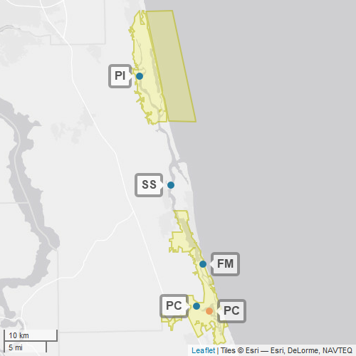
GTM
Guana Tolomato Matanzas (GTM) is one of 30 sites in the National Estuarine Research Reserve Systems (NERRS). Each site is a state-federal partnership that combines research, monitoring, and education to advance the understanding and management of estuarine environments.
NERRS
Centralized Data
Management Office
GTM
GTM Storm Monitoring
Weather Station
GTM NERR operates a weather station located at Pellicer Creek (PC) and maintains four continuous, long-term water quality stations at Pine Island (PI), San Sebastian (SS), Fort Matanzas (FM), and Pellicer Creek (PC) locations. GTM NERR is part of the SWMP. As Hurricane Irma approached Florida, GTM NERR monitored the weather and water quality, collecting data every 15 minutes for the following parameters: air temperature, relative humidity, atmospheric pressure, rainfall, wind speed and direction, water temperature, depth, salinity, dissolved oxygen, turbidity, and pH.
Water Quality Sample Location

Slide 3
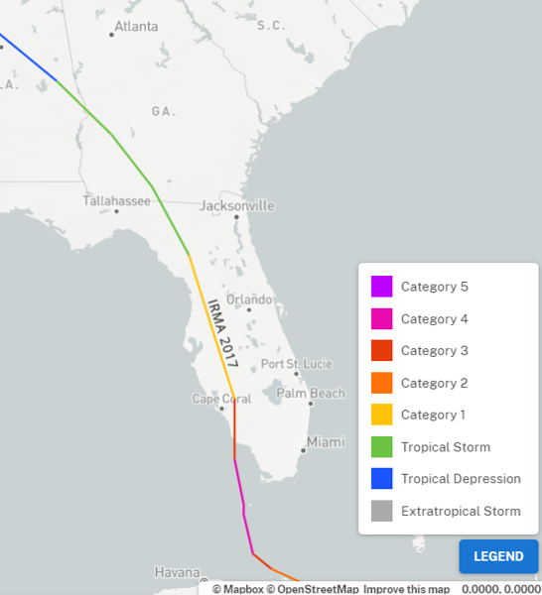
On Sep. 9 Irma turned northwestward towards Florida and made landfall in Cudjoe Key on Sep. 10 as a Cat. 4. Irma weakened to a Cat. 3 before making landfall again at Marco Island. Irma accelerated inland to the north-northwest, weakening to a Cat. 1 on Sep. 11, passing east of Tampa and weakened to a tropical storm as it entered Georgia.
Flooding occurred on most rivers in northern Florida. The St. John’s River set record flood stages at many locations in Duval County, causing major flooding in the Jacksonville metropolitan area, where hundreds of people were rescued.
Source: https://oceanservice.noaa.gov/news/historical-hurricanes/
Irma transitioned between a Cat. 1 hurricane to a Tropical Storm as it impacts reached the reserve.
NOAA NCEI estimates that the total cost of Irma was $80 billion (adjusted for 2022), making Irma the 6th most destructive hurricane to affect the United States.
GTM
Aquatic life, like oysters, crabs, shrimp, fish, phytoplankton, etc. rely on specific levels of salinity and dissolved oxygen to thrive and survive. The weather impacts from Irma caused significant drops in the levels of salinity and dissolved oxygen for varying periods of time, potentially stressing organisms.
Station | Date | Total Precipitation (in) | Average Intensity Precipitation (in/hr) | Max Wind Speed (mph) | Average Wind Speed (mph)
Pellicer Creek | 9/8/2017 | 0.38 | 0.016 | 19.0 | 14.6
Pellicer Creek | 9/9/2017 | 0.91 | 0.038 | 25.7 | 20.6
Pellicer Creek | 9/10/2017 | 2.27 | 0.094 | 39.8 | 27.7
Pellicer Creek | 9/11/2017 | 6.49 | 0.270 | 65.1 | 38.7
Pellicer Creek | 9/12/2017 | 0.03 | 0.001 | 19.5 | 9.9
The highest local rainfall and wind measurements were recorded at the reserve when Irma moved inland and north-northwest across Florida on Sep. 11.
Data reporting time periods for Hurricane Irma: 9/7/2017 - 9/11/2017

Slide 4
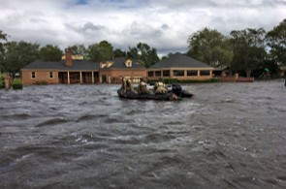
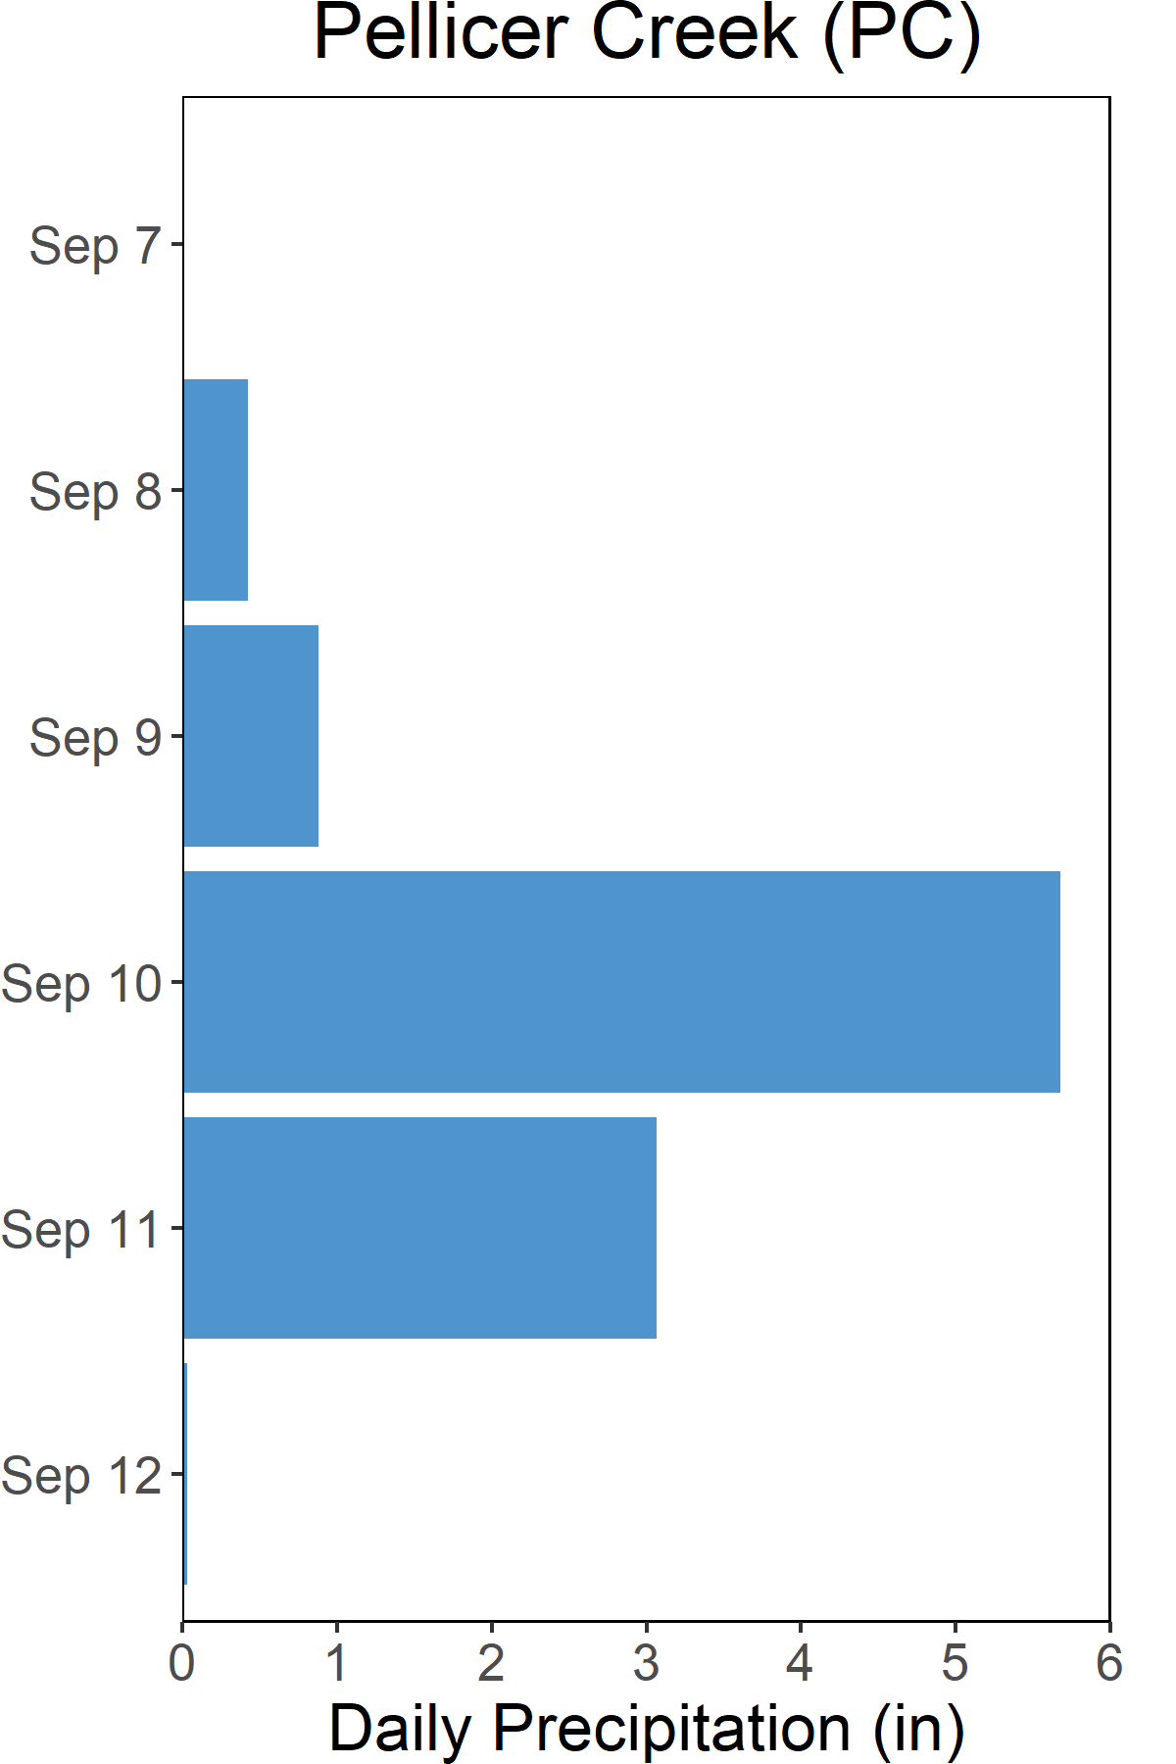

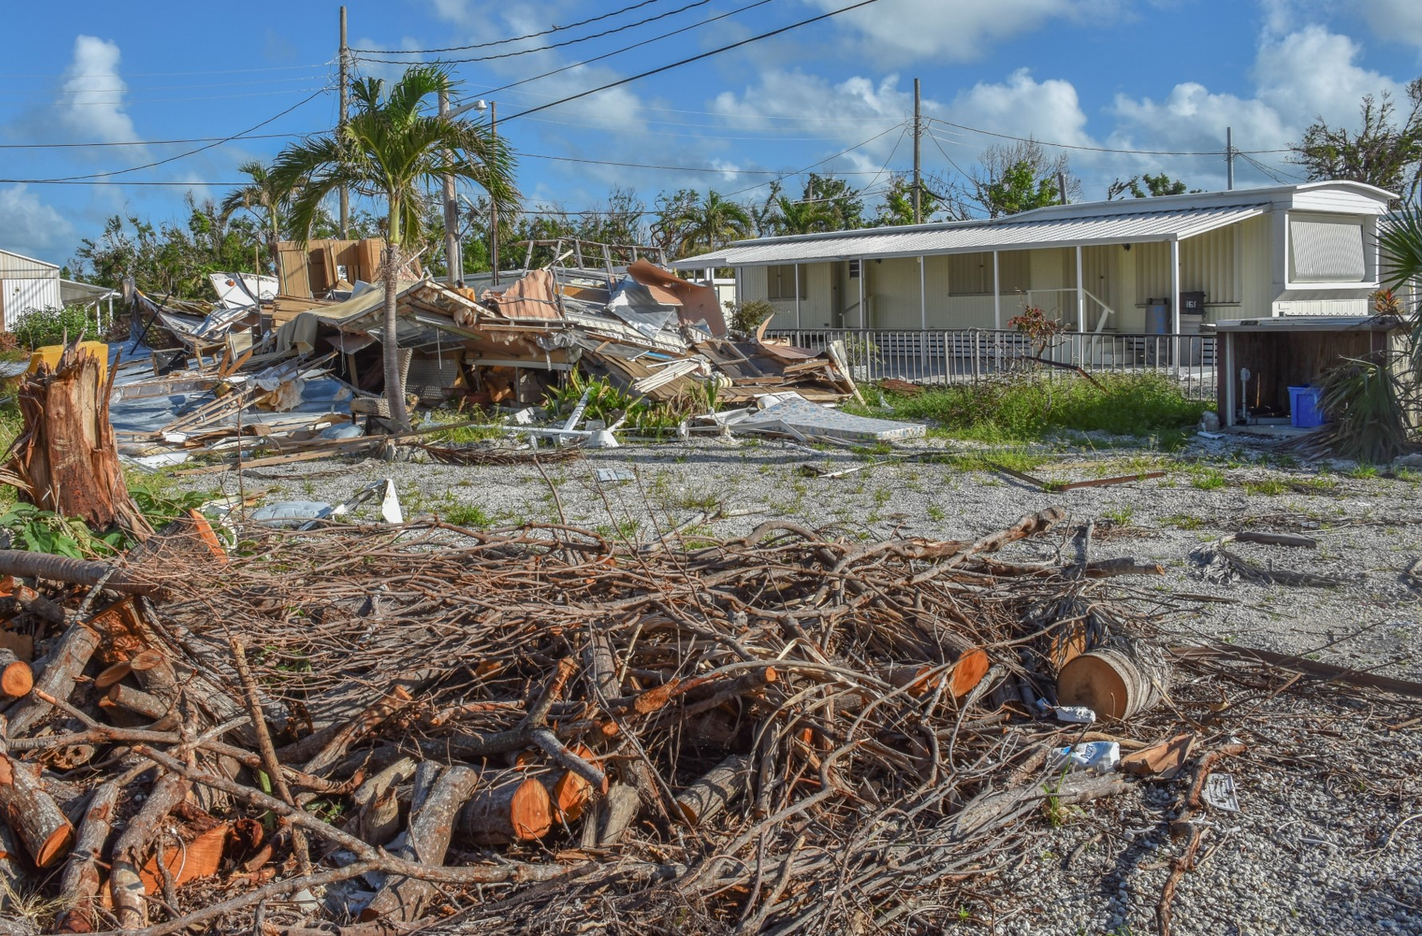
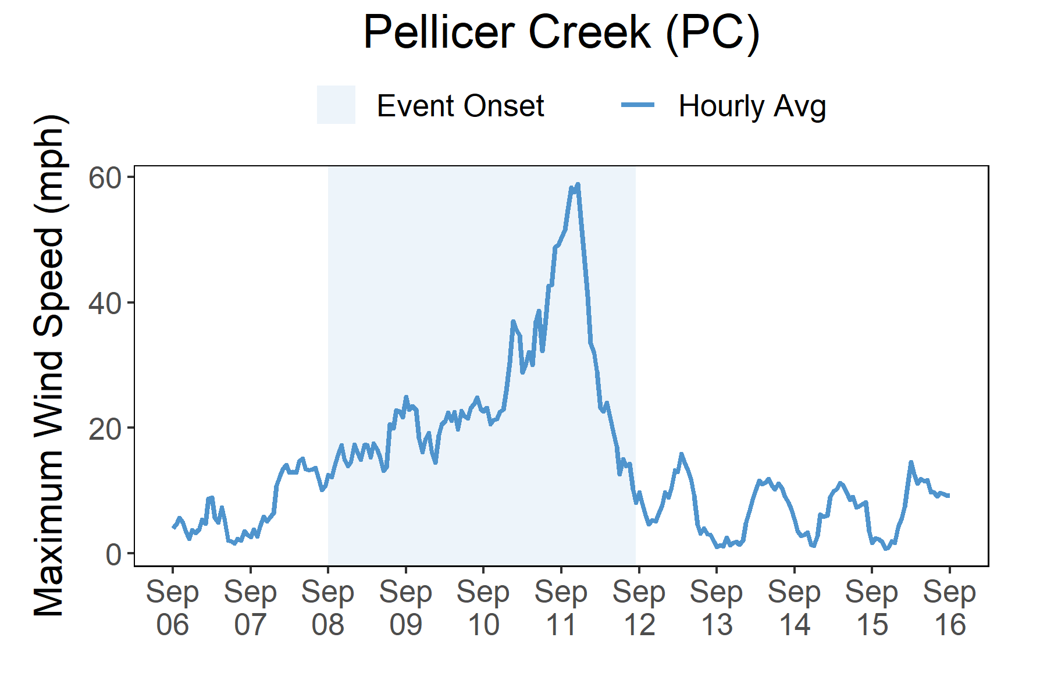

Rainfall
Irma brought heavy rains, high winds, storm surge, and freshwater flooding to Florida.
A total of 10 inches of rainfall fell in the reserve area over the course of five days as a result of the heavy rain-producing Hurricane Irma.
Heavy rains and high winds impacted northeastern Florida with 10 total inches rainfall and a max wind speed of 65 mph recorded at the Pellicer Creek weather station. The Matanzas River south of St. Augustine recorded a wave-filtered water level of 6.65 ft NAVD88 (4.8 ft MHHW), and the USGS surveyed several high water marks of 2 to 4 ft above ground level in that area. The highest was a mark of 3.3 ft above ground level near Vilano Beach. Even though Irma made landfall along the southwestern coast of Florida, the hurricane’s large wind field produced significant storm surge flooding along the northeastern coast of Florida.
In northern Florida, flooding was the biggest issue. Rivers that reached major or record flood stage caused significant flooding in the Jacksonville area. Floodwaters filled the city’s streets and reached up to 5 ft deep in some locations reaching record-breaking levels in some locations. Overall Irma was responsible for one of the worst flooding events in the city’s 225+ year history. The northeastern portion of the state also experienced hurricane-force wind gusts and embedded tornadoes that caused structural damage to homes and businesses. There was also widespread tree and power line damage across the area.
Rainfall measurements at the weather station from Sep. 7 through Sep 12.
Wind Speed
Max wind speed recorded at the reserve was 65 mph on Sep. 11.
Maximum Wind Speed readings at the weather station from Sep. 6 through Sep. 16.

Slide 5
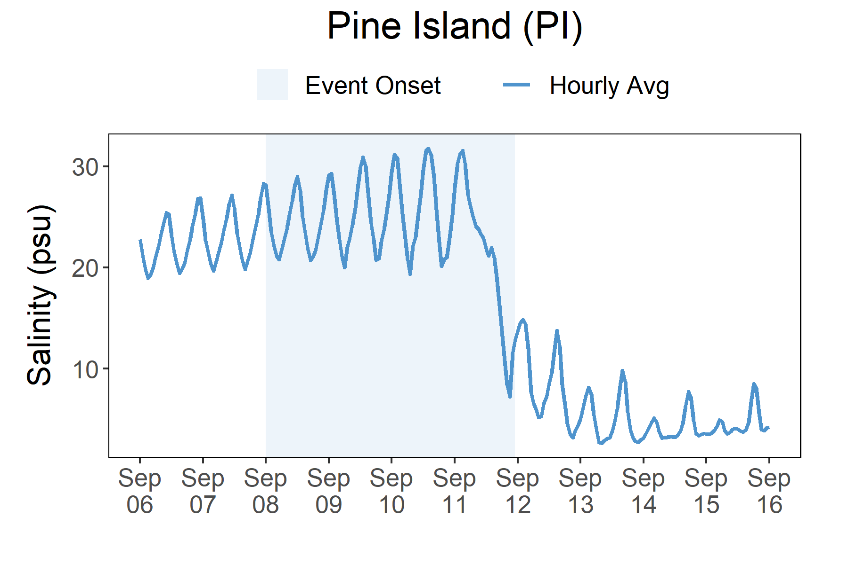
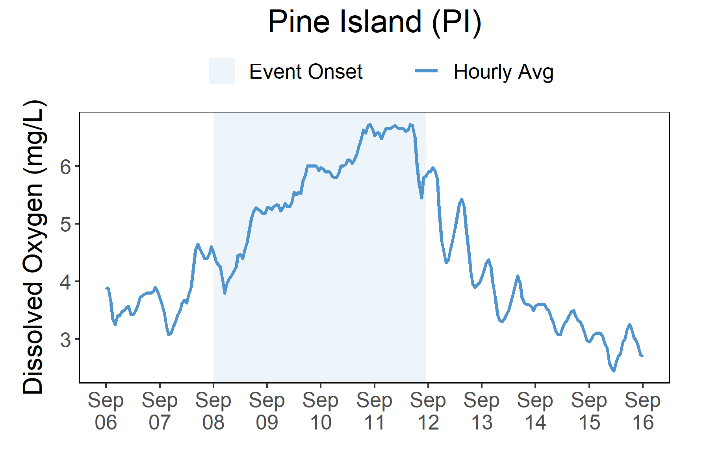
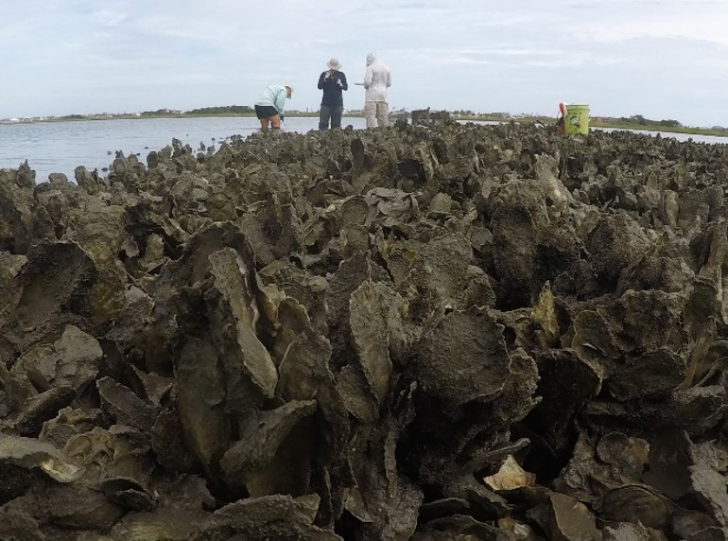
On Sep. 12, salinity levels quickly dropped at Pellicer Creek in response to the heavy rains and flooding that resulted as Irma passed over the north-northwest part of the state on Sep. 11.
Station | Date | Depth Maximum (ft) | Salinity Minimum (psu) | Salinity Maximum (psu) | Dissolved Oxygen Minimum (mg/L) | Dissolved Oxygen Maximum (mg/L)
Pine Island | 9/8/2017 | 13.48 | 20.1 | 29.2 | 3.6 | 5.3
Pine Island | 9/9/2017 | 14.07 | 19.5 | 31.1 | 5.1 | 6.0
Pine Island | 9/10/2017 | 14.83 | 18.3 | 31.9 | 5.8 | 6.5
Pine Island | 9/11/2017 | 16.40 | 12.6 | 31.8 | 6.4 | 6.8
Pine Island | 9/12/2017 | 13.52 | 4.7 | 14.9 | 4.2 | 6.2
Data reporting time periods for Hurricane Irma: 9/7/2017 - 9/11/2017
Salinity
Dissolved Oxygen
Post-Storm Levels <5 to <10 psu
Dissolved oxygen
levels increased during the storm
A big and fast drop in salinity occurred as flooding followed after heavy rainfall
Pre-Storm Levels ~18 to >30 psu
Salinity levels from Sep. 6 through Sep 16.
Dissolved Oxygen levels from Sep. 6 through Sep. 16.
Salinity and dissolved oxygen levels recorded at Pellicer Creek show initial and post-storm impacts on water quality. Salinity levels quickly dropped from the heavy rains and flooding and remained at lower levels for for several days after the hurricane had passed. Dissolved oxygen levels increased during the storm's impact and then returned to lower levels within a few short days. Dramatic changes in salinity can cause stress to some aquatic organisms depending on the species and how long the levels deviate from what is normal. Water quality stresses can impact survival and future populations.
Oyster reef in the Matanzas River south of St. Augustine, Florida.

Slide 6
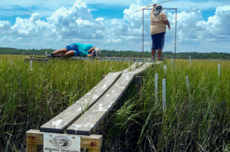
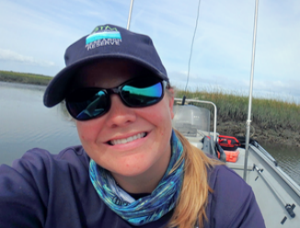
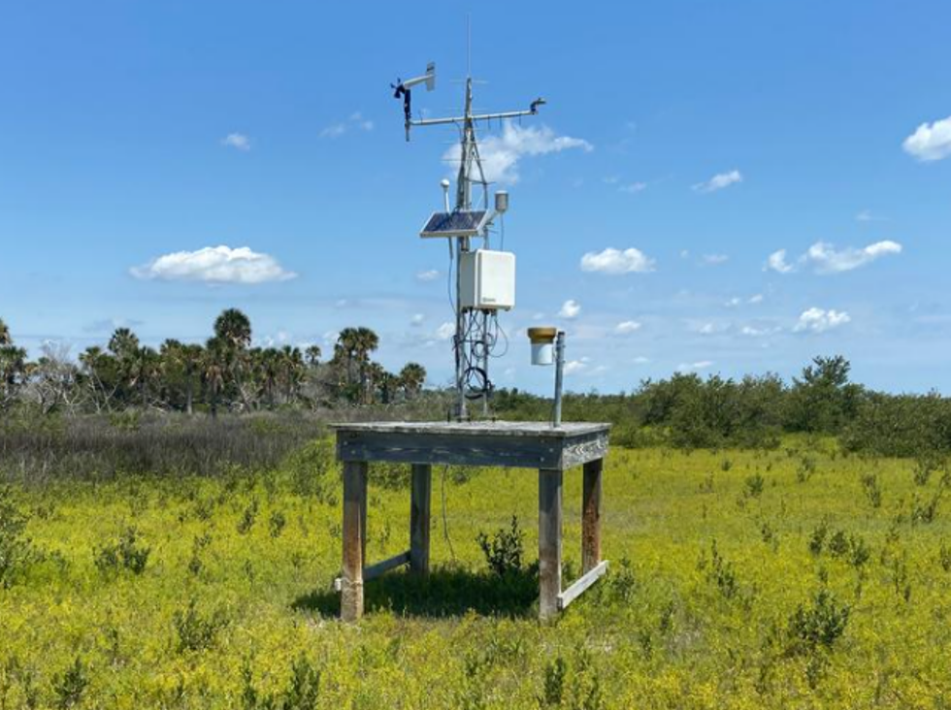
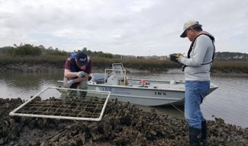
Kaitlyn Dietz, Coastal Training Coordinator e: gtmresearchreserve@gtmnerr.org p: 904.823.4500
Visit www.nerrsdata.org to view and download weather and water quality data from GTM NERR.
Interested in learning more? Visit www.gtmnerr.org. For video, news updates, and online storm data and prediction visualization tools, check out our Storm Story Map at www.storm storymap.url.
@GTMResearchReserve

